Slide 1

investor deck
SLEEP BETTER – CATCH THE Night TRAIN! scientifically proven novel solution
JUHA RYTKY
CEO

Slide 2
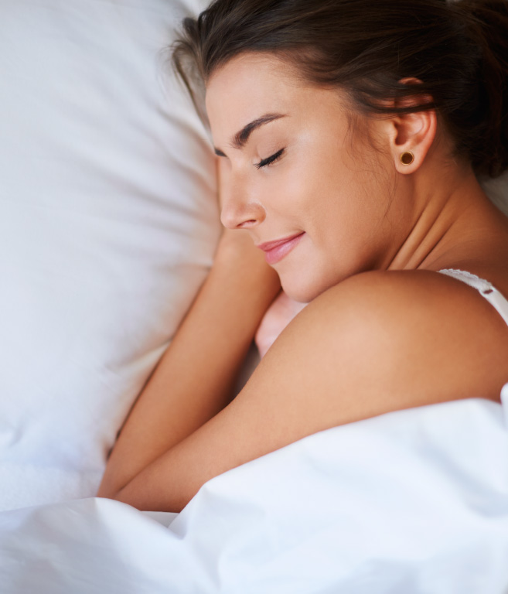
ABOUT US
NIGHT TRAIN OY
FOUNDER Juha Rytky
SHAREHOLDERS Founders, Butterfly Ventures and private investors
VISION We develop digital services that help people to monitor and care for their health
PRODUCTS The first product is the most accurate and advanced digital sleep analysis solution
TARGET MARKET Health and well-being market including health diagnostic, wearable and smartwatch companies
LOCATIONS Oulu, FINLAND

Slide 3
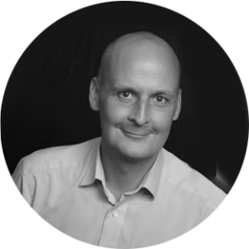

Management team
Founder and CEO Juha Rytky has been working for 15+ years in start-up companies. Juha’s experience covers operations, patenting, fund raising, sales and marketing activities. He has acted as the CEO of start-up companies for more than a decade and holds several patents and applications related to sensor technologies. His ambition is to create a digital health application and services which improve the quality of everyday life and well-being.
Chief Scientific Officer, Heikki Pylkkö is the dedicated problem-solver looking for ways to make human life better, more fulfilling, and more sustainable by creating something that truly works. He has 20+ years experience as the entrepreneur and his special skills are on machine learning, neuro networks and creating an algorithms. Before joining to Night Train Heikki ran his own companies Intopii Oy and Cloveland Oy 22 years. At Night Train Heikki is responsible for data analysis, mathematical modeling and development of algorithm.
https://fi.linkedin.com/in/juha-rytky-8585122
https://www.linkedin.com/in/heikkipylkko/

Slide 4



PEOPLE BEHIND the VISION
Timo Partonen, Research Professor at the National Institute for Health and Welfare (THL). Timo has published 200+ original peer-reviewed scientific articles. He has edited two scientific books on seasonal affective disorder for Oxford University Press, the first of which was awarded First Prize in the British Medical Association’s Medical Book Competition in the Mental Health Category in 2002. The focus areas of Timo’s research are the details of the mechanisms by which the metabolic, cell-division, circadian and sleep-wake cycles are linked and contribute to mood.
Anu-Katriina Pesonen, Sleep Scientist, Professor of clinical and developmental psychology at the University of Helsinki, with expertise in epidemiology, paediatrics and psychiatry. Anu-Katriina has 154 publications to her name and her main research interests are interdisciplinary, combining psychology with paediatrics, epidemiology and psychiatry. Currently, she is working as a Principal Investigator on two projects. The first examines children's sleep from an interdisciplinary perspective, the second the relationship between sleep and physical activity.
Liisa Kuula-Paavola, Research professor at Helsinki University. Liisa is in charge of research operations at the Helsinki University sleep Liisa focuses on her research work for sleep and stress in health and in transition from acute to chronic diseases.

Slide 5
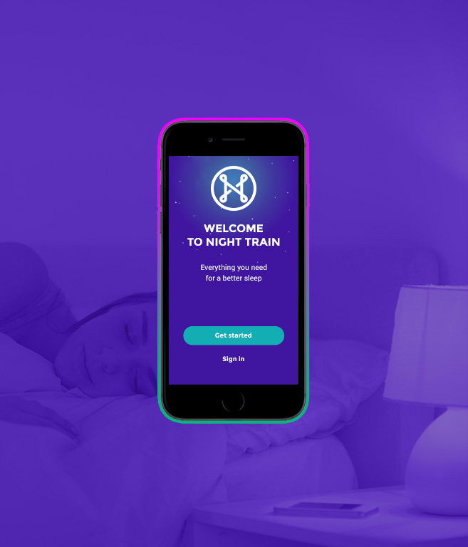
solution
Sleep is the single most important influence on health and well-being.
Night Train has developed the most accurate sleep analysis technology, in partnership with sleep researchers and professors at Helsinki University and Finnish Institute for Health and Welfare .
It is the only technology which can determine the melatonin onset – the circadian cycle. It helps people to find their natural sleep cycle, which is the key to better sleep quality, health and overall well-being.

Slide 6
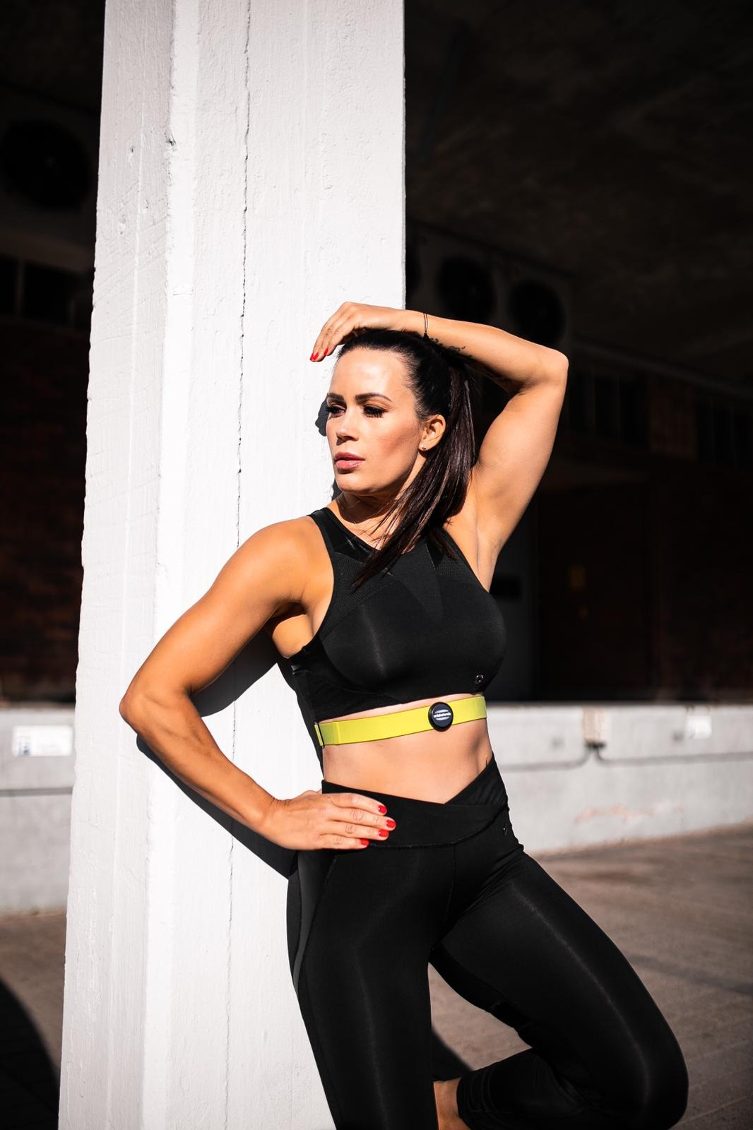
Existing products
Night Train Sleep analysis provides the most accurate information on sleep quality and duration. And it is the only technology that can determine natural sleep cycle.
Night Train Recovery analysis measures the heart rate variability (HRV) only during deep sleep stages and therefore provides more accurate results on physical recovery.
Stress level and mental recovery can be very accurately measured by the relative duration of REM sleep. Sleep quality combined with heart rate variability is a very rich data to determine overall physical and mental recovery.

Slide 7
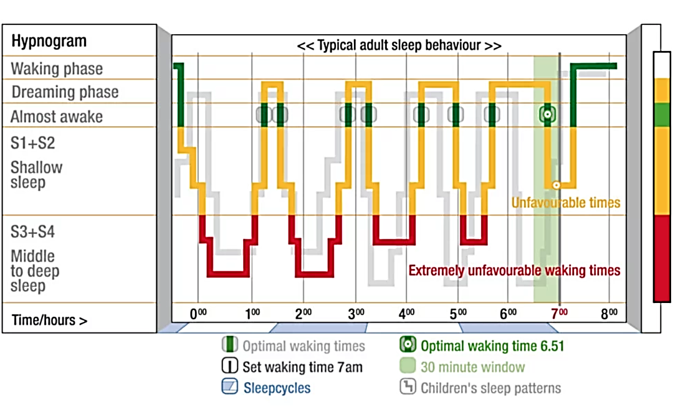

Slide 8
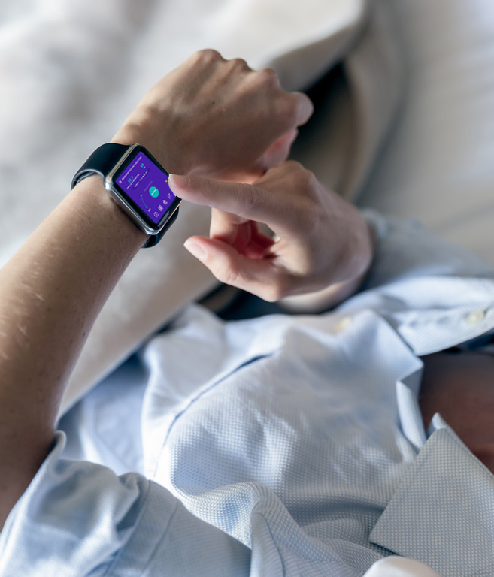
Competitive advantages
Circadian Cycle – Melatonin onset gives rise to noticeable temperature changes at the wrist, which makes it easy to identify using wearable devices.
Sleep Analysis – distal skin temperature changes together with HRV and body movements give the most accurate analysis of the sleep stages, fall asleep time, sleep onset latency and sleep time.
Recovery occurs only during the REM and deep sleep stages and is therefore a very accurate measure of mental and physical recovery.

Slide 9
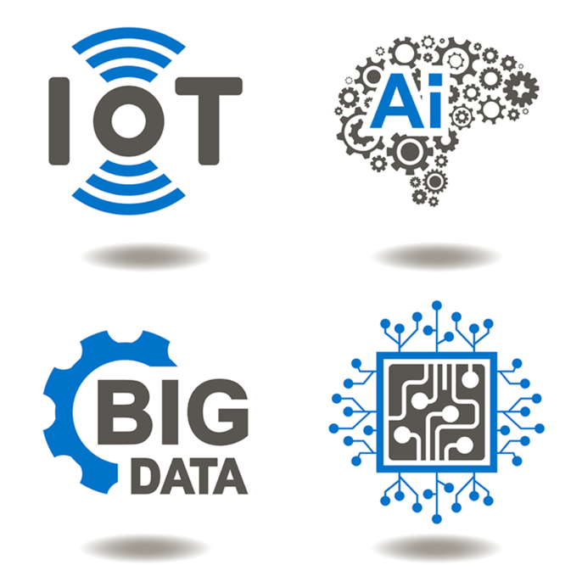
technology
Night Train sleep analysis algorithm uses 30+ carefully selected features from heart rate, body movements and distal skin temperature changes which correlate with the sleep stages.
State-of-the-art machine/deep learning methods have been used to achieve high accuracy for sleep analysis with reasonable computational requirements.
The algorithms have proved to work towards the polysomnography with 100+ test subjects.

Slide 10
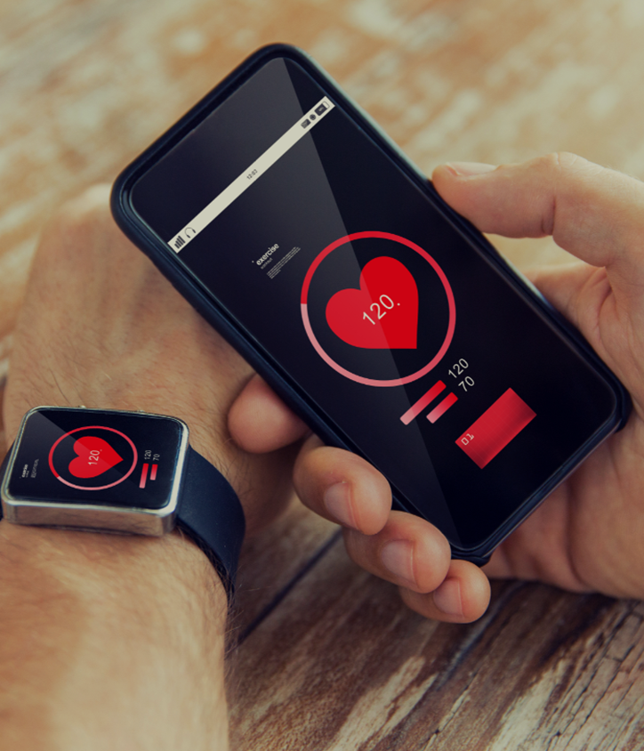
ROADMAP
Sleep Aponea Analysis Q2/2020
It is estimated that about 20% of people in western countries suffer from sleep aponea without knowing it. Sleep aponea is very dangerous disease because it increases the risk of developing diabetes, overweight, depression, heart diseases and significantly reduces the quality of well-being.
The symptoms of sleep aponea can be measured by respiratory failures. Respiratory failures can be measured by heart rate variation using a wearable devices.

Slide 11
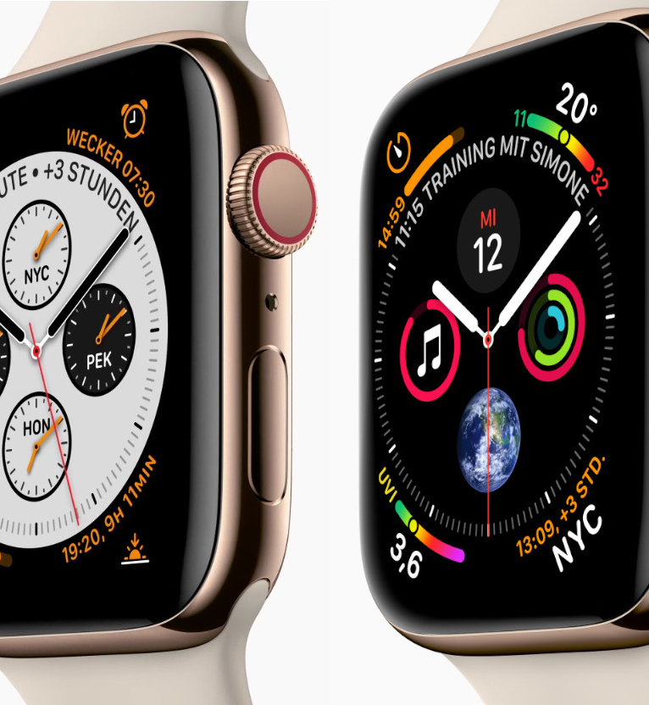

Market entry
Q1/2020
The first customer agreement has been signed with Navigil Oy and a technology integration has started in December 2019. Navigil pays 24k€ project fee and a 1€ license fee per sold device.
The target is to scale sales significantly in 2020. Ava Bracelet and Huawei have already started a technology evaluation process, Samsung, Denso, Timex, Suunto, Beurer, Valencell and Ouraring have shown very strong interest towards our technology offering.

Slide 12
Sales pipeline and wearable market forecast
Q1/2020
Q2/2020
Navigil (Licencing)
Huawei (Evaluation)
Burer (Evaluation)
Q3/2020
Leads
Timex (Licencing)
Samsung (Evaluation)
Huami (Evaluation)
Ava Bracelet
Ouraring
Omron
Huami
Xiaomi
Do Intelligence
Medisana
Valencell
Greenteg
Motorola
Ava Bracelet (Licencing)
Suunto (Licensing)
Samsung (Licencing)
Xiaomi (Evaluation)
Ouraring (Licencing)
Huawei (Licencing)
Timex (Licencing)
Huami (Licencing)
Potential Customers
Fitbit / Google Apple
Polar Electro Sony
Garmin Fossil
MyKronoz etc…

Slide 13
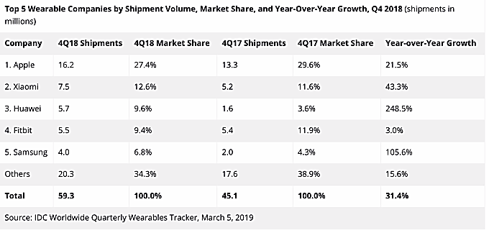
Wearable market in 2018

Slide 14
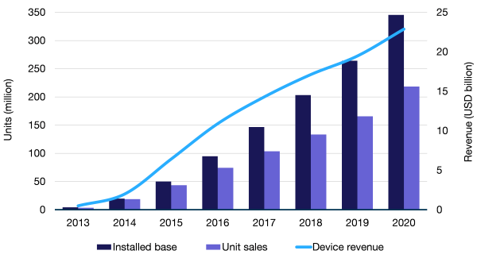
Wrist-worn Wearable market forecast
There were around 120m wearables on the market in 2018, according to the market research company, Analysis Mason. At the same time, the wearables market was worth over $10bn, forecast to grow to over $20bn by 2020, Moreover, the forecast indicates that there will be abou 350m wrist-worn devices on the market in 2020.
In 2018, Apple was the market leader, with a sales volume of about 40m sold units, followed by Samsung, Huawei, Huami and Fitbit with 20m+ shipped units each.

Slide 15

Business model
Technology licensing
Night Train licenses technologies for wearable and smartwatch companies. Customers pay the technology integration and licence fee to Night Train according the sales volume.
Software as a Service
Customer provides just a sensor data to Night Train’s cloud service and recieves analysis back to their device. Customer pays a fee per analysis provided by Night Train.

Slide 16

INTELLECTUAL PROPERTY RIGHTS
The patent application PCTFI2017050582 ”Method and system for determining time window for sleep of a person” was filed on 25 August 2016. EPO patent has granted in Feb 2020.
A second set of patent application PCTFI2018050030 “Method, apparatus and system for detecting stages of sleep of a person” was filed in January 2018. The application is now in the PCT phase and national filing will be started in Q4/2019.
The Night Train trademark has been registered in the EU, China and the USA.

Slide 17
Financial forecast

Slide 18



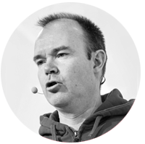
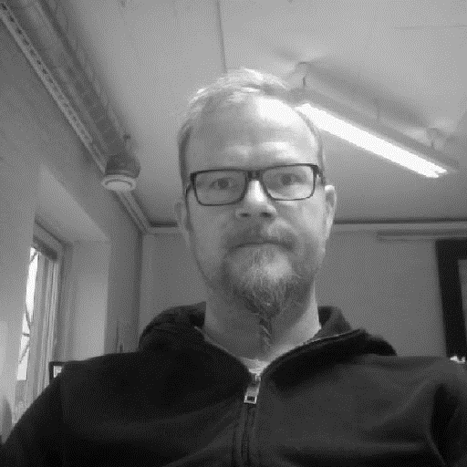

Private investors and AdvisorY board
Olli-Pekka Piira, Jussipekka Marttila, Ville Puukka
M.D. Cardiologist M.D. Specialist in Occupational Health Orthopaedic Surgeon
Peter Vesterbacka, Teemu Puhakka, Heikki Huhta,
Business Evangelist Doctor and Editor in Chief at Tervemedia M.D., Ph.D. Surgeon

Slide 19
FINANCING
WHY Night Train?
EXPERIENCED TEAM
UNIQUE AND PATENTABLE INNOVATION(S)
MVp exists first customer agreement signed
Market entry in Q4/2019
SCALABLE BUSINESS MODEL
NIGHT TRAIN IS NOW SEEKING A-ROUND FINANCING OF EURO 300,000
The instrument is a new issue of A-class shares (the only share class). The Company is a Finnish Limited Liability company.
The investment will be used for scaling the business, IP protection and product development.
It is possible to apply for additional funding from the Finnish Funding agency for Innovation (TEKES) up to 1m€.
A Customary Shareholders Agreement is available with strong minority protection rights. rhythms of distal skin temperature and sleep propensity vary inversely across the day and night.
Melatonin induces the sleep train – time window to go to sleep and it can be measured very accurately from the distal skin temperature changes.

Slide 20
THANK YOU!
Juha Rytky, Founder, CEO • tel. +358 40 934 7117• juha.rytky@ntrain.fi

Slide 21
LONG-TERM HEALTH IMPACT OF SLEEP PATTERN
HEIGHTENED RISK FACTOR FOR DIABETES. Too much sleep can be as bad for you as too little: people who regularly get less than 6 or more than 9 hours of sleep each night are both faced with an increased risk for type 2 diabetes.
INCREASED RISK FOR BREAST CANCER. A survey of breast-cancer patients found a strong association between shorter sleep patterns and recurrence of tumours. This suggests that women who don’t sleep enough each night (less than 6 hours) have an increased risk for more aggressive cancer.
HIGH BLOOD PRESSURE. There is also a strong link between short sleep duration and hypertension, as well as a connection (although not as significant) between too much sleep and hypertension.
MAJOR DEPRESSION. Insomniacs and others who don’t get adequate sleep each night are ten times as likely to develop major depression as those who sleep through the night. Because depression also has a negative effect on sleep patterns, this can create a cycle that is hard to break
DECREASED IMMUNE FUNCTION. According to the Mayo Clinic, people who don’t sleep enough each night get less protection from flu vaccines and are more likely to catch the common cold.
OBESITY. The rising rate of obesity seems to parallel Americans’ tendency to sleep less than ever before, prompting a Harvard study to investigate. The results were surprising – brain scans of sleepy adults showed that they were less likely to distinguish between high-calorie and low-calorie foods; the part of the brain that inhibits and controls emotions and behaviour was not active. This can lead to overeating and making poor food choices in general, which contributes to obesity. Other studies have found that lack of sleep may affect the hormones that tell you when you are full – this causes you to overeat when you’re sleepy.

